Slide 1
The Logic of Experimental Verifiability
Assumptions of Physics collaboration

Slide 2
Outline
Issue fundamental object (in math is a set)
Science is about describing the world, but not all descriptions of the world are science
Require -> Principle of scientific objectivity (examples of non-universal, contradictory, non-verifiable or semi-decidable)
Two parts: first solve non-contradiction, then solve evidence based
Statements
Problem of web of meaning, and idealization of statements (“conceptual cut”) -> statements being prime objects (i.e. unstructured)
Show the divide between formal and informal
Need justifications for axioms and definitions; axioms and definitions are chosen because they allow for simple justification (not because mathematicians like them)
Problems in capturing self-consistency (paradoxes, semantic and formal) -> Axiom of context
Truth is found experimentally, it has to be consistent with the meaning of the statements -> Axiom of possibility
Dependency between statements -> Axiom of closure
Logic operations, Equivalence (different equivalence), Boolean algebra, Narrowness and independence, minterms
Verifiable
Finite time verification (also idealization) – Not convenient to formalize the tests (knowing what is testable assumes knowing the laws of physics – circularity!)
Axiom of verifiability
Problem with NOT – falsifiable/decidable
Axioms of finite conjunction, countable disjunction
Summary of the logic

Slide 3
If we wanted to construct an axiomatic theory for all experimental science, what should our primitive notion be?

Slide 4

Principle of scientific objectivity: science is universal, non-contradictory and evidence based.
Guiding principle
Suggest logic as fundamental …
Universal $→$ same for everybody
like mathematics!
Non-contradictory $→$ something is either true or false
Evidence based $→$ truth is determined experimentally
… with some extensions
$⇒$ Logic of experimentally verifiable statements!

Slide 5
Logic of statements

Slide 6
Logical context

Slide 7
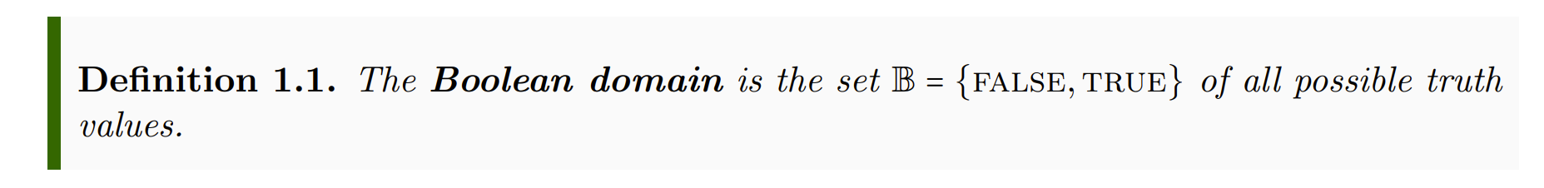
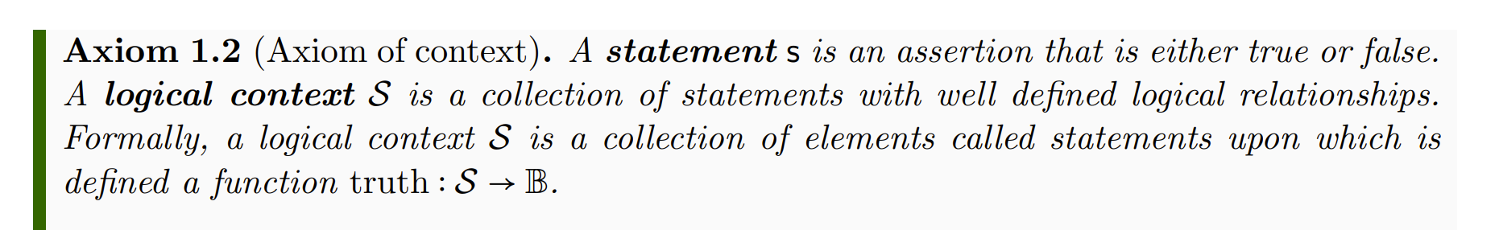
Informal part
Formal part
Informal
Formal
Each axiom/definition has two parts:
Informal part: tells us what elements in the physical world we are characterizing
Formal part: how the elements are characterized mathematically
physics
math
Each axiom/definition has a justification:
argues why the mathematical characterization follows from the physical one

Slide 8
Informal part
Formal part
Informal
Formal
Axiom: brings objects from the informal to the formal
physics
math
Definition: further specializes formal objects
Axioms/definitions should be formulated so that they are easy to justify…
… not so that they follow trends in mathematics

Slide 9
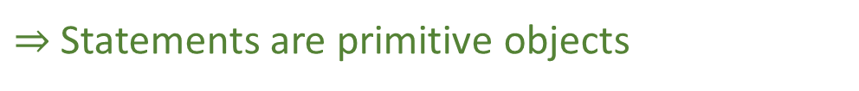
Informal part
Formal part
Informal
Formal
Physical objects are made “mathematically precise” by throwing out everything that can’t be made precise
physics
math
Syntax, grammar, meaning, … can’t be made precise, so are not part of the formal system
$⇒$ Statements are primitive objects

Slide 10
Informal part
Formal part
In mathematics, primitive objects (i.e. those that are left unspecified) must be elements of a set. The logical context, then, has two functions:
1) in the formal system, it is the “container” for the primitive objects (i.e. the statements)
2) in the informal system, consistency/semantics/… are properties of groups of statements (i.e. of the context)

Slide 11
Informal part
Formal part
A statement here represents the assertion and not the sentence that declares the assertion. Therefore the translation of a sentence into another language represents the same statement.
Technically, we only assume the existence of valid statements for doing science. Therefore statements are also primitives in the informal system.
But if they exist, they must follow the axioms we are going to specify.

Slide 12

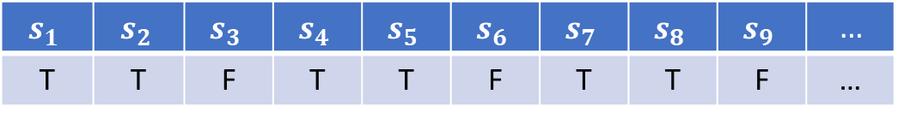

Informal part
Formal part
The existence of a truth function stems from the assumption of non-contradiction and universality.
Every statement must be either true or false for everybody.
$$𝒮$$
$$s_{1}$$ | $$s_{2}$$ | $$s_{3}$$ | $$s_{4}$$ | $$s_{5}$$ | $$s_{6}$$ | $$s_{7}$$ | $$s_{8}$$ | $$s_{9}$$ | $$…$$
T | T | F | T | T | F | T | T | F | …
$$truth$$
Context $⇒$ big table where statements are columns

Slide 13
Possible assignments and logical relationships

Slide 14
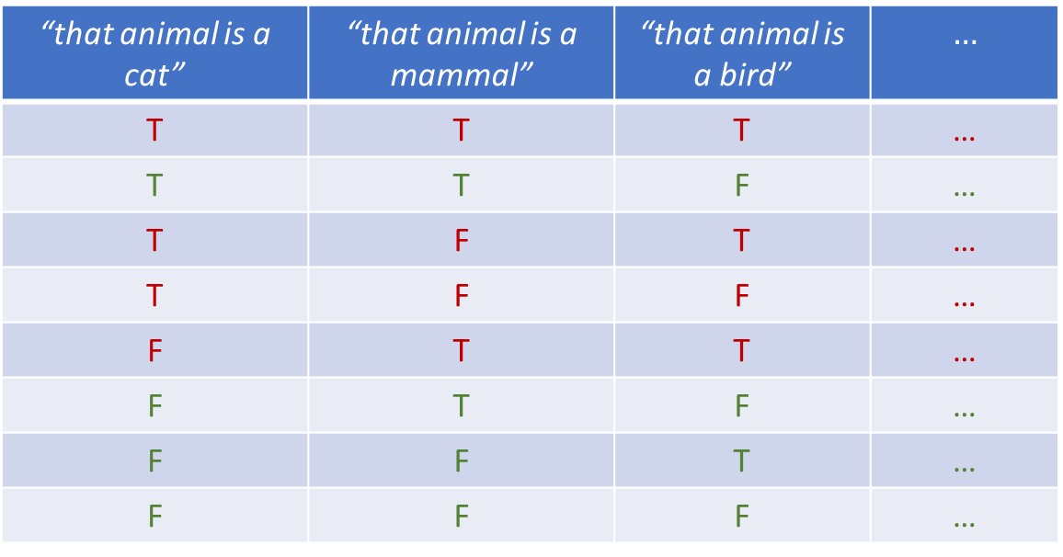
Note: the semantic content constrains the possible combinations of truth values
“that animal is a cat” | “that animal is a mammal” | “that animal is a bird” | $$…$$
T | T | T | …
T | T | F | …
T | F | T | …
T | F | F | …
F | T | T | …
F | T | F | …
F | F | T | …
F | F | F | …
impossible
The only semantics captured by the formal system is the set of possible combinations of truth values
Notes:
Part of the semantic content of the statements is captured by what truth value can be assigned; Possible assignments are determined by the semantic content of the statements

Slide 15
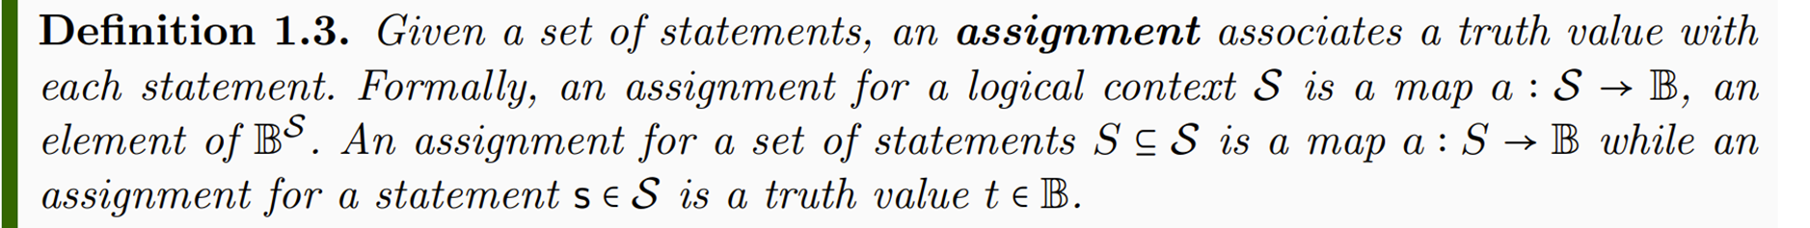


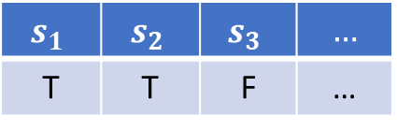

$$s_{1}$$ | $$s_{2}$$ | $$s_{3}$$ | $$…$$
T | T | F | …
$$a$$
assignment for whole context
$a{\left.​\right|}_{\left\{s_{1},s_{2}\right\}}$
$$a(s_{3})$$
assignment for a set of statements
assignment for a single statement

Slide 16
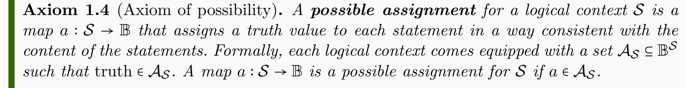


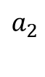

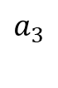


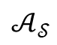
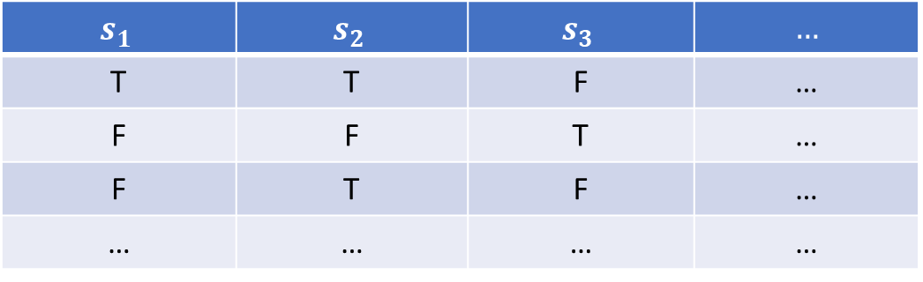
$$s_{1}$$ | $$s_{2}$$ | $$s_{3}$$ | $$…$$
T | T | F | …
F | F | T | …
F | T | F | …
… | … | … | …
$$a_{1}$$
$$truth$$
$$a_{2}$$
$$𝒜_{𝒮}$$
$$a_{3}$$
$$…$$
Possible assignments are those assignments consistent with the meaning (semantics) of the statements
Context $⇒$ big table where statements are columns and possible assignments are rows

Slide 17
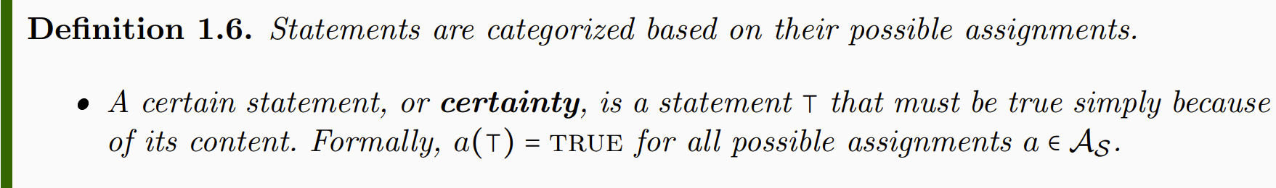
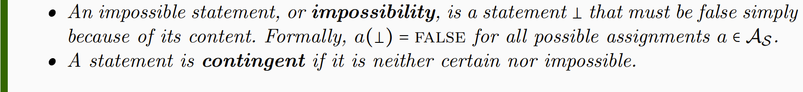
“that cat is a mammal” | “that mammal is a cat” | “that mammal is a bird”
T | T | F
T | F | F
certain
contingent
impossible
Certainties and impossibilities have the same truth value in all rows
Notes:
NOTE: whether a statement is a certainty or not depends on context. Mass of the electron: contingent if measuring the mass, certainty for particle identification

Slide 18

Whether a statement is certain or contingent depends on context!
the mass of the electron is 510 $±$ 0.5 KeV
Contingent when measuring the mass of the electron
Certain when performing
particle identification
Notes:
NOTE: whether a statement is a certainty or not depends on context. Mass of the electron: contingent if measuring the mass, certainty for particle identification

Slide 19
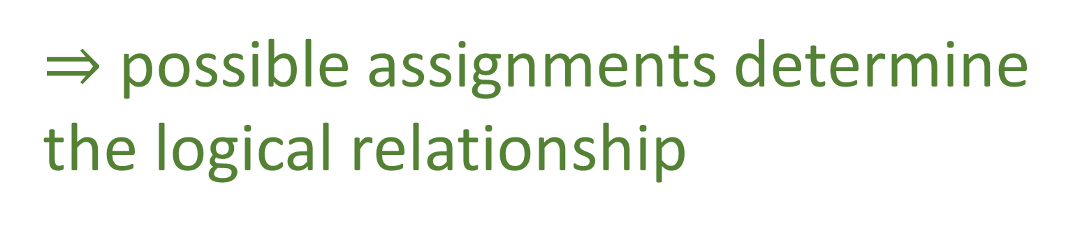
Some statements depend on other statements
That animal is a mammal
That animal has feathers
incompatible
narrower
equivalent
That animal is a cat
That animal is a bird
independent
That animal is black
negation
That animal is not black
$⇒$ possible assignments determine the logical relationship
Notes:
Want to keep track whether the truth of one statement depends on the truth of others: function on truth values – introduce truth tables

Slide 20
Equivalent
Independent
“that animal has feathers” | “that animal is a bird”
T | T
T | F
F | T
F | F
 | T | F
T | ü | û
F | û | ü
“that animal is a cat” | “that animal is black”
T | T
T | F
F | T
F | F
 | T | F
T | ü | ü
F | ü | ü
Incompatible
“that animal is a mammal” | “that animal is a bird”
T | T
T | F
F | T
F | F
 | T | F
T | û | ü
F | ü | ü

Slide 21
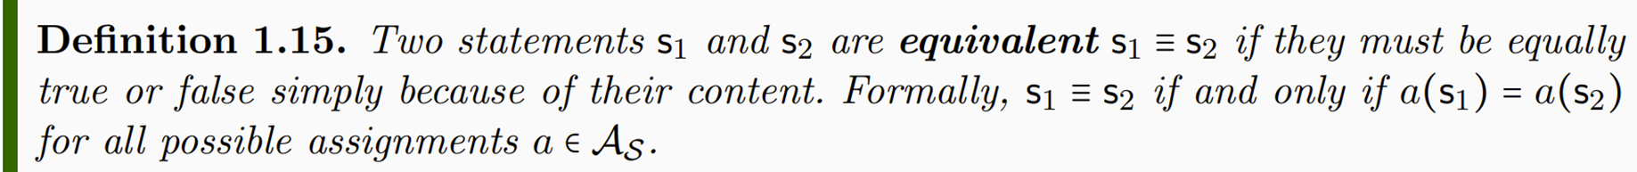
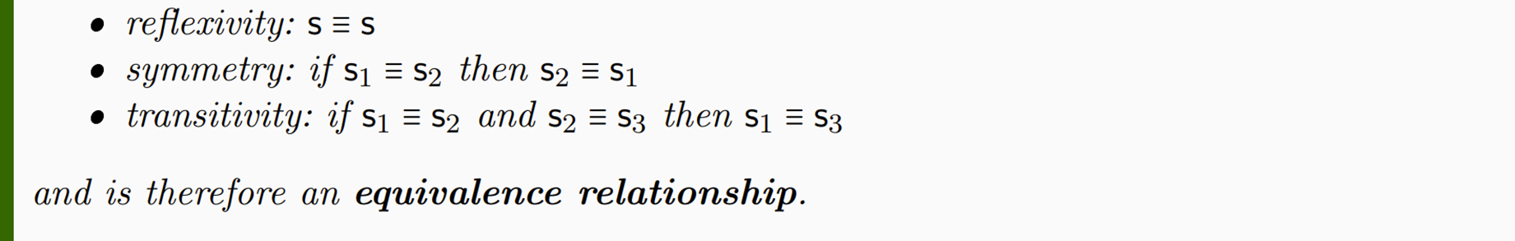

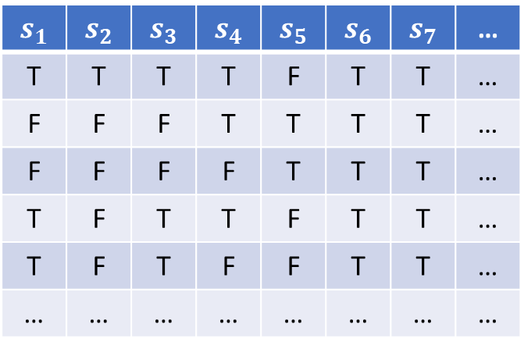
$$s_{1}$$ | $$s_{2}$$ | $$s_{3}$$ | $$s_{4}$$ | $$s_{5}$$ | $$s_{6}$$ | $$s_{7}$$ | …
T | T | T | T | F | T | T | …
F | F | F | T | T | T | T | …
F | F | F | F | T | T | T | …
T | F | T | T | F | T | T | …
T | F | T | F | F | T | T | …
… | … | … | … | … | … | … | …
$$≡$$
$$≡$$
Notes:
Different notion of equivalence Table 1.2

Slide 22
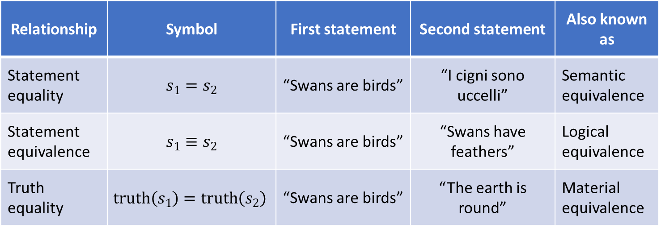
Three types of statement equivalence
Relationship | Symbol | First statement | Second statement | Also known as
Statement equality | $$s_{1}=s_{2}$$ | “Swans are birds” | “I cigni sono uccelli” | Semantic equivalence
Statement equivalence | $$s_{1}≡s_{2}$$ | “Swans are birds” | “Swans have feathers” | Logical equivalence
Truth equality | $$truth\left(s_{1}\right)=truth\left(s_{2}\right)$$ | “Swans are birds” | “The earth is round” | Material equivalence
We can distinguish between the three cases within the same framework
From now on, if otherwise stated, by statement we mean an equivalence class of statements

Slide 23
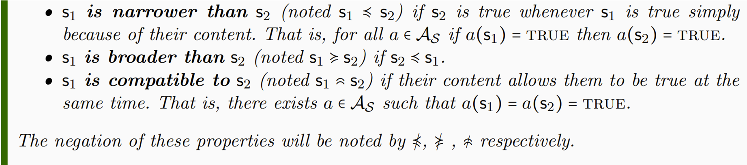

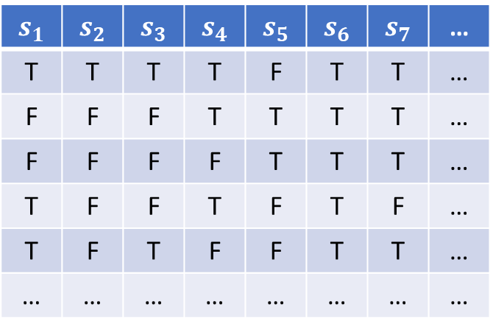

$$s_{1}$$ | $$s_{2}$$ | $$s_{3}$$ | $$s_{4}$$ | $$s_{5}$$ | $$s_{6}$$ | $$s_{7}$$ | …
T | T | T | T | F | T | T | …
F | F | F | T | T | T | T | …
F | F | F | F | T | T | T | …
T | F | F | T | F | T | F | …
T | F | T | F | F | T | T | …
… | … | … | … | … | … | … | …
That animal is a mammal That animal lays eggs
That animal is a cat $≼$ That animal is a mammal
$$≼$$

Slide 24
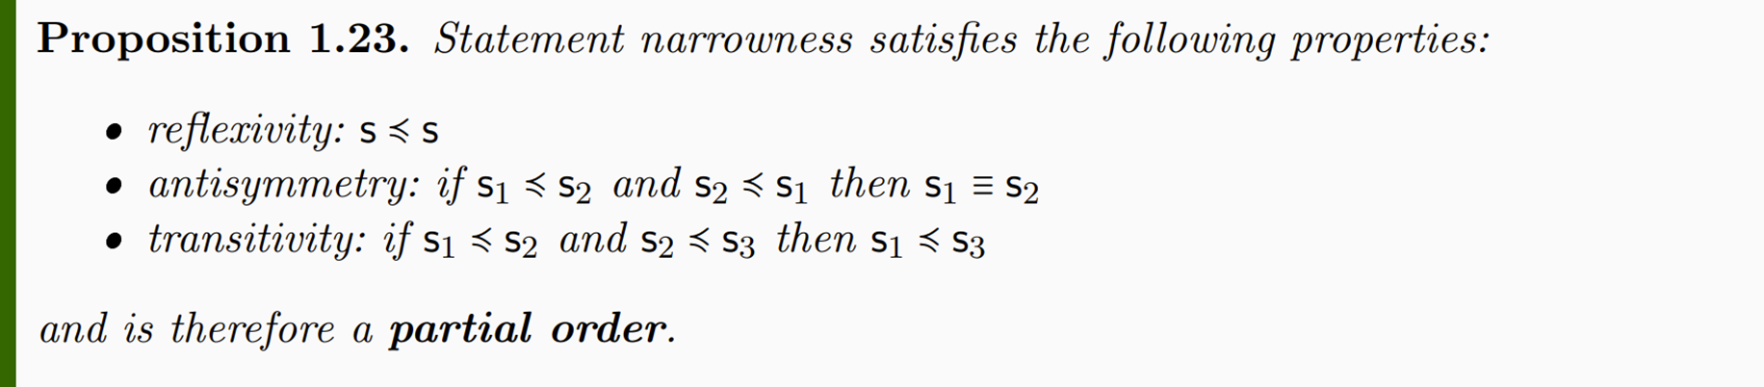

Narrowness $≼$ is related to material implication $→$ but:
Material implication is a logical operation that returns a new statement:
$a→b=¬a∨b$ (i.e. NOT(a) OR b )
Narrowness $≼$ is a binary relationship between statements
The order imposed by narrowness allows us to understand the context as an order theoretic structure

Slide 25

NOTE: AND, OR and NOT ($∧, ∨,¬$) are operations within the context
Equivalence, narrowness, compatibility, … ($≡,≼, ,…)$
are not: they describe the context (i.e. metalanguage)

Slide 26
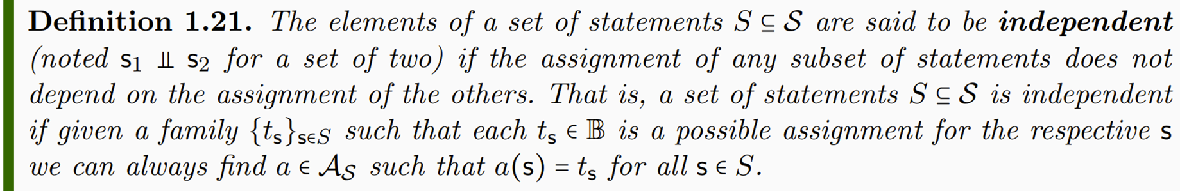
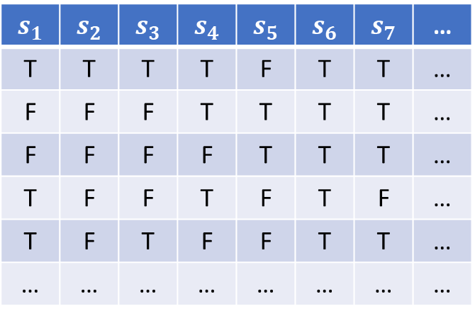

$$s_{1}$$ | $$s_{2}$$ | $$s_{3}$$ | $$s_{4}$$ | $$s_{5}$$ | $$s_{6}$$ | $$s_{7}$$ | …
T | T | T | T | F | T | T | …
F | F | F | T | T | T | T | …
F | F | F | F | T | T | T | …
T | F | F | T | F | T | F | …
T | F | T | F | F | T | T | …
… | … | … | … | … | … | … | …
That animal is a cat That animal is black

Slide 27
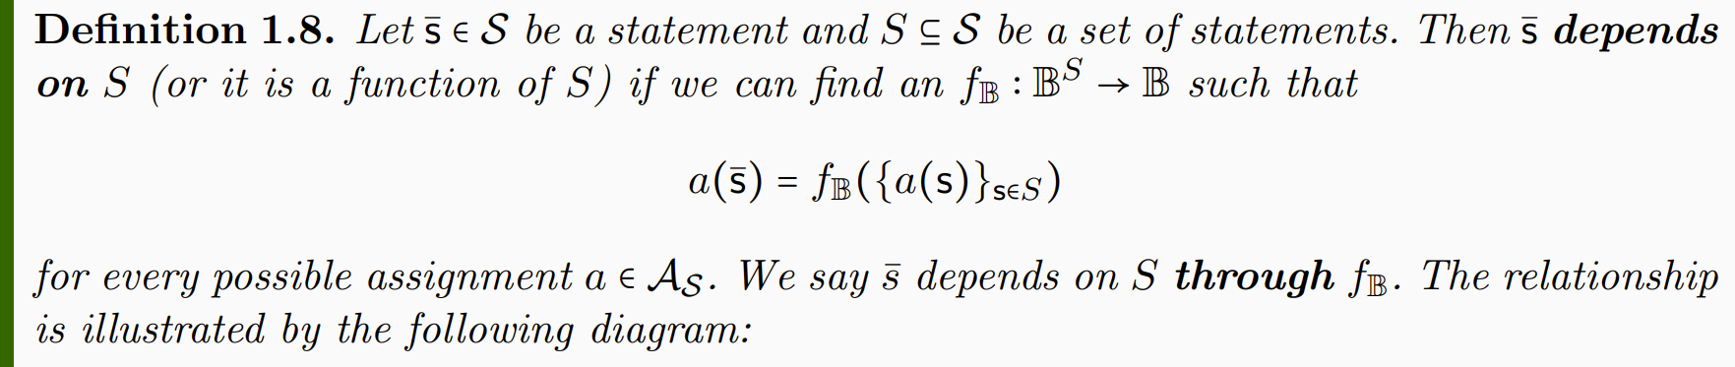










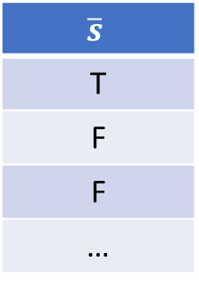



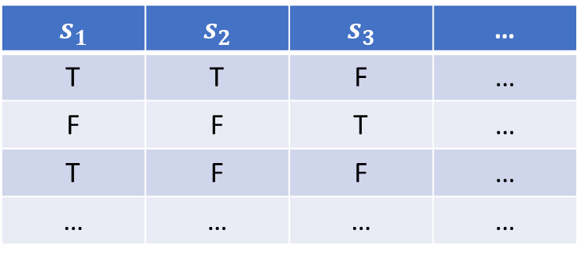


$$s_{1}$$ | $$s_{2}$$ | $$s_{3}$$ | …
T | T | F | …
F | F | T | …
T | F | F | …
… | … | … | …
…
…
…
…
…
$$\overline{s}$$
T
F
F
…
$$a_{1}$$
$a_{1}$($\overline{s})=$ $f_{𝔹}(a_{1}(s_{1})$, $a_{1}(s_{2}$), $a_{1}(s_{3}$))
$$a_{2}$$
$$f_{𝔹}$$
$a_{2}$($\overline{s})$= $f_{𝔹}(a_{2}(s_{1})$, $a_{2}(s_{2}$), $a_{2}(s_{3}$))
$$𝒜_{𝒮}$$
$$a_{3}$$
$s_{1}$ AND ${(s}_{2} OR{ s}_{3})$
$a_{3}$($\overline{s})$= $f_{𝔹}(a_{3}(s_{1})$, $a_{3}(s_{2}$), $a_{3}(s_{3}$))
$$…$$
$f_{𝔹}$(…,…,…)
$$S$$
$s_{1}$=“that animal is a cat”
$s_{2}$=“that animal is a mammal”
$s_{3}$=“that animal is a bird”
Notes:
Applying truth tables to the assignments

Slide 28
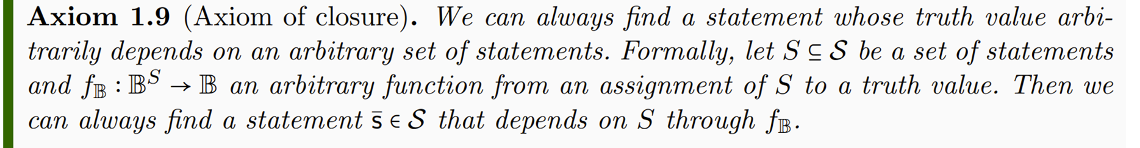


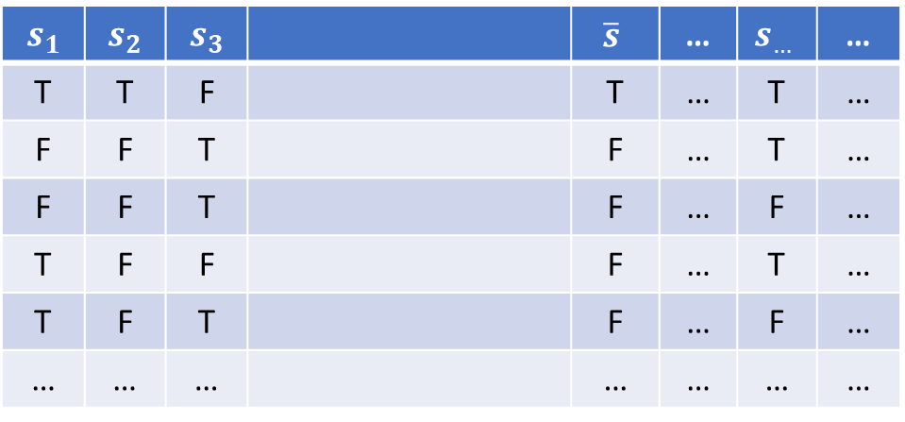
$$s_{1}$$ | $$s_{2}$$ | $$s_{3}$$ |  | $$\overline{s}$$ | … | $$s_{…}$$ | …
T | T | F |  | T | … | T | …
F | F | T |  | F | … | T | …
F | F | T |  | F | … | F | …
T | F | F |  | F | … | T | …
T | F | T |  | F | … | F | …
… | … | … |  | … | … | … | …
Not sure whether it is needed as an axiom: the closure may be proven to exist and be unique.
$$f_{𝔹}$$
$s_{1}$ AND ${(s}_{2} OR{ s}_{3})$
Notes:
The logical context will allows allow all possible truth functions

Slide 29
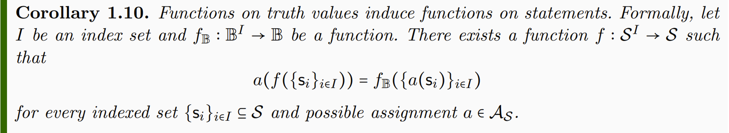

$$f(s_{1},s_{2},s_{3})$$
$$s_{1}$$ | $$s_{2}$$ | $$s_{3}$$ |  | $$\overline{s}$$ | … | $$s_{…}$$ | …
T | T | F |  | T | … | T | …
F | F | T |  | F | … | T | …
F | F | T |  | F | … | F | …
T | F | F |  | F | … | T | …
T | F | T |  | F | … | F | …
… | … | … |  | … | … | … | …
$$f_{𝔹}$$
$s_{1}$ AND ${(s}_{2} OR{ s}_{3})$
Notes:
-> Functions on truth values induce functions on statements

Slide 30
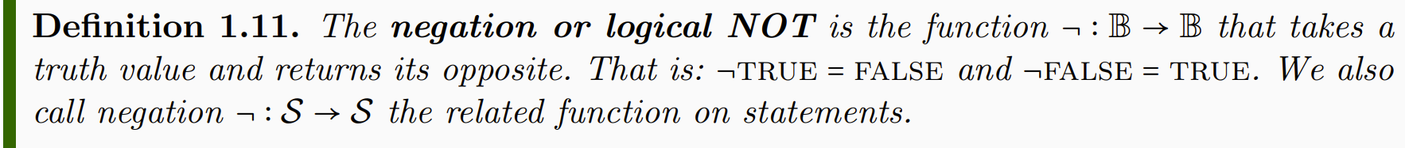


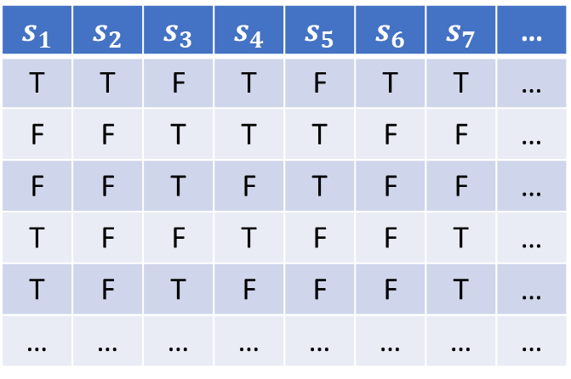
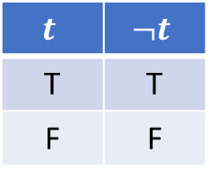
$$t$$ | $$¬t$$
T | T
F | F
$$s_{1}$$ | $$s_{2}$$ | $$s_{3}$$ | $$s_{4}$$ | $$s_{5}$$ | $$s_{6}$$ | $$s_{7}$$ | …
T | T | F | T | F | T | T | …
F | F | T | T | T | F | F | …
F | F | T | F | T | F | F | …
T | F | F | T | F | F | T | …
T | F | T | F | F | F | T | …
… | … | … | … | … | … | … | …
That animal is a cat
$$¬$$
That animal is not a cat
$$¬$$

Slide 31
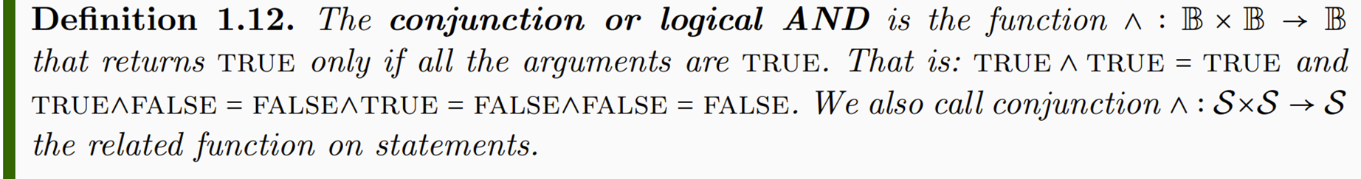
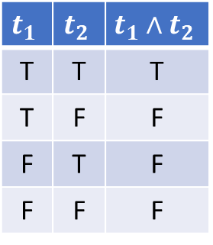


$$t_{1}$$ | $$t_{2}$$ | $$t_{1}∧t_{2}$$
T | T | T
T | F | F
F | T | F
F | F | F
$$s_{1}$$ | $$s_{2}$$ | $$s_{3}$$ | $$s_{4}$$ | $$s_{5}$$ | $$s_{6}$$ | $$s_{7}$$ | …
T | T | F | T | F | T | T | …
F | F | T | T | T | F | F | …
F | F | T | F | T | F | F | …
T | F | F | T | F | F | T | …
T | F | T | F | F | F | T | …
… | … | … | … | … | … | … | …
That animal is a cat
That animal is black
$$∧$$
That animal is a black cat
$$∧$$

Slide 32
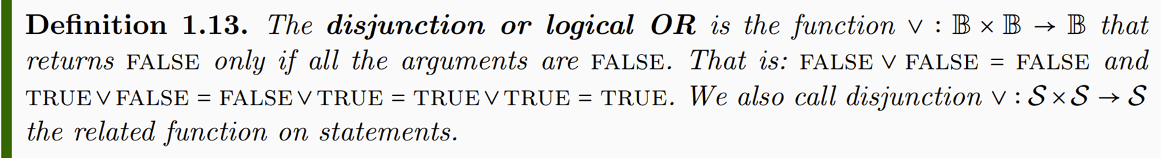
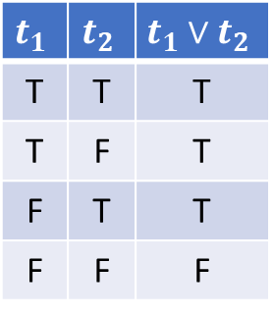


$$t_{1}$$ | $$t_{2}$$ | $$t_{1}∨t_{2}$$
T | T | T
T | F | T
F | T | T
F | F | F
$$s_{1}$$ | $$s_{2}$$ | $$s_{3}$$ | $$s_{4}$$ | $$s_{5}$$ | $$s_{6}$$ | $$s_{7}$$ | …
T | T | F | T | F | T | T | …
F | F | T | T | T | F | F | …
F | F | T | F | T | F | F | …
T | F | F | T | F | F | T | …
T | F | T | F | F | F | T | …
… | … | … | … | … | … | … | …
That animal is a cat
That animal is a dog
$$∨$$
That animal is a cat or a dog
$$∨$$

Slide 33
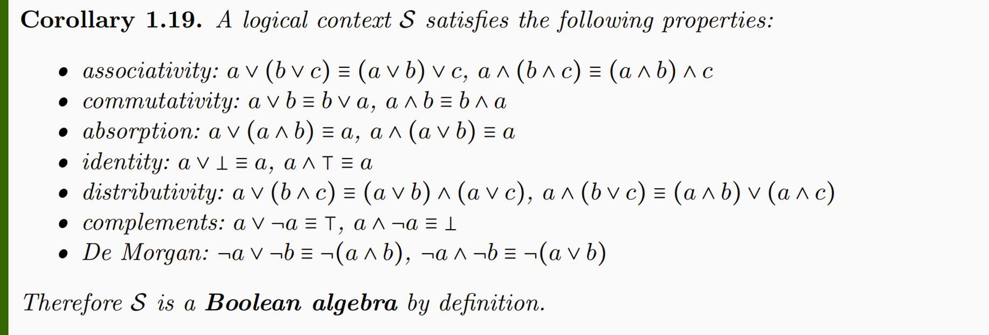
Recovers the standard structure for classical logic
Note how many properties are part of the definition of a Boolean algebra: if that had been our starting point, we would have had to justify every single one, which is cumbersome and not particularly enlightening

Slide 34
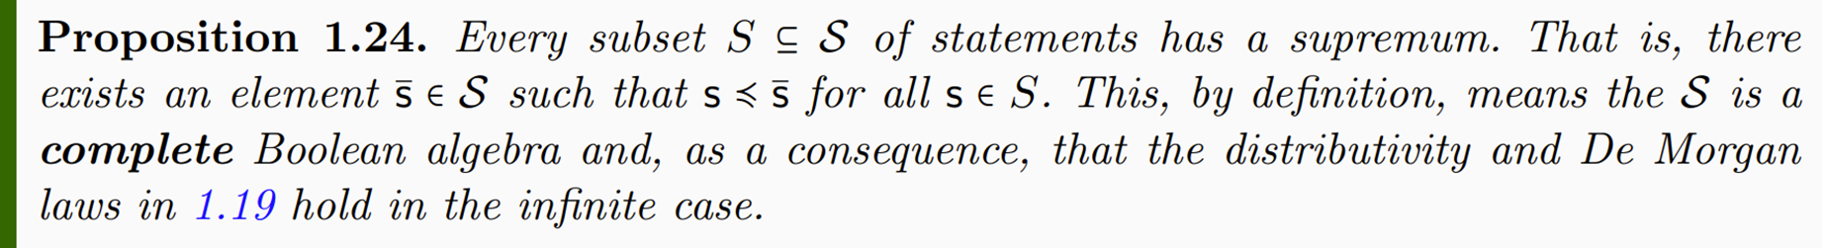
A logical context is a complete lattice
This means that all properties generalize to the infinite case

Slide 35


Two (standard) ways to look at the logical context
Algebra: set of elements together with some operations $\left(∧,∨,¬\right)$
Geometry, probability, measure theory related to this view
Partially ordered set (POSET): ordered set of elements $\left(≼\right)$
System composition/decoupling related to this view
$$supremum\left(\left\{a,b\right\}\right)⇒a∨b$$
connection
$$a∨b=b⇒a≼b$$

Slide 36

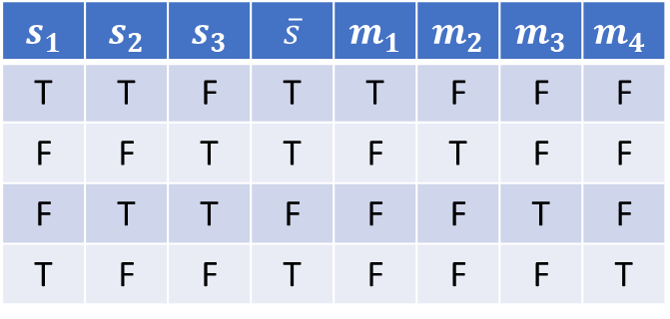



Functions in a Boolean algebra have a standard representation important for us
$m_{1},m_{2}, m_{3},m_{4}$ each picks a line of the table, and can be expressed as the conjunction that takes $s_{1},s_{2},s_{3}$ once, negated or not
$$s_{1}$$ | $$s_{2}$$ | $$s_{3}$$ | $$\overline{s}$$ | $$m_{1}$$ | $$m_{2}$$ | $$m_{3}$$ | $$m_{4}$$
T | T | F | T | T | F | F | F
F | F | T | T | F | T | F | F
F | T | T | F | F | F | T | F
T | F | F | T | F | F | F | T
$m_{1}=s_{1}∧s_{2}∧¬s_{3}$
$m_{2}=¬s_{1}∧¬s_{2}∧s_{3}$
$m_{3}=¬s_{1}∧s_{2}∧s_{3}$
$m_{4}=s_{1}∧¬s_{2}∧¬s_{3}$
minterms
$\overline{s}$ is a function of $s_{1},s_{2},s_{3}$
$\overline{s}$ is the disjunction of $m_{1},m_{2},m_{4}$
$$\overline{s}=\left(s_{1}∧s_{2}∧¬s_{3}\right)∨\left(¬s_{1}∧¬s_{2}∧s_{3}\right)∨\left(s_{1}∧¬s_{2}∧¬s_{3}\right)$$
disjunctive normal form

Slide 37
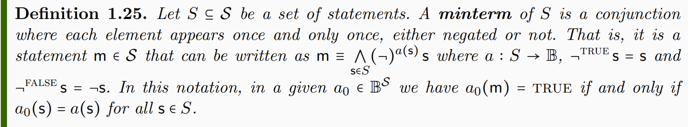
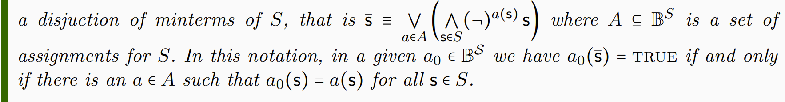
Formally

Slide 38
Logic of verifiable statements

Slide 39
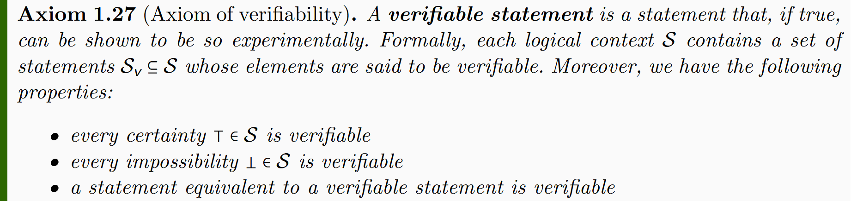
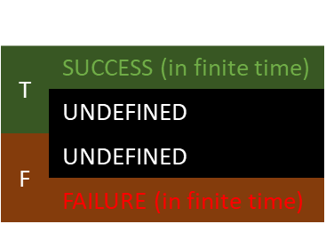
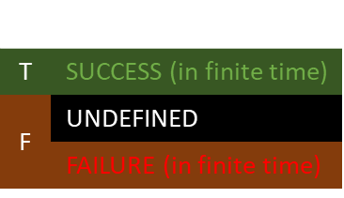
New axiom to bring in the idea that some statements are experimentally verifiable
statement
experimental test
Statements are verifiable if there is a test that always terminates successfully if the statement is true
$$s$$ | $$e$$
T | SUCCESS (in finite time)
 | UNDEFINED
F | UNDEFINED
 | FAILURE (in finite time)
$$s$$ | $$e$$
T | SUCCESS (in finite time)
F | UNDEFINED
 | FAILURE (in finite time)
Tests may or may not terminate

Slide 40
The tests are not objects in the mathematical framework
Defining tests formally is cumbersome
Capturing which statements are verifiable is enough
Formally we are only “tagging” which statements are verifiable
Only need to tag the verifiable statements: all other tests can be constructed from those

Slide 41
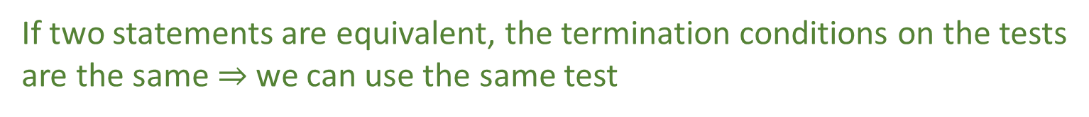
Certainties and impossibilities are defined to be true and false, therefore a trivial test that always succeeds or fails is adequate
If two statements are equivalent, the termination conditions on the tests are the same $⇒$ we can use the same test

Slide 42
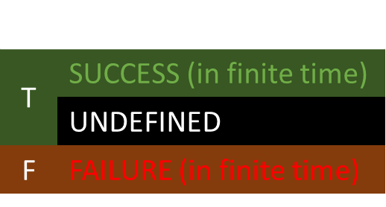

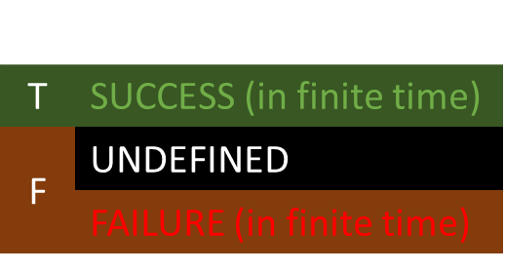

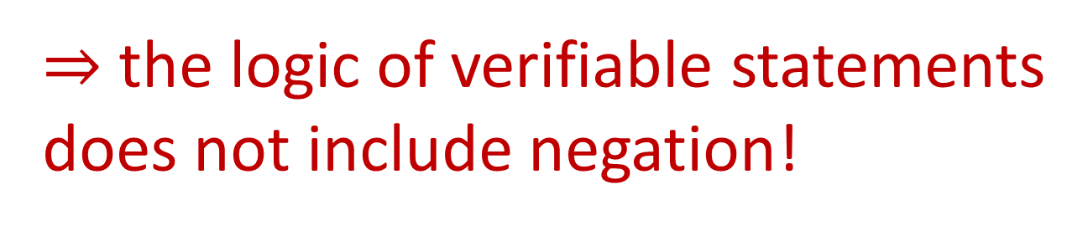
$$s$$ | $$e$$
T | SUCCESS (in finite time)
F | UNDEFINED
 | FAILURE (in finite time)
$$¬s$$ | $$e_{¬}(e)$$
T | SUCCESS (in finite time)
 | UNDEFINED
F | FAILURE (in finite time)
$e_{¬}(e)$:
Run test $e$
If $e$ fails, return SUCCESS
If $e$ succeeds, return FAILURE
From $e$, we can construct the test $e_{¬}(e)$ that switches SUCCESS with FAILURE,
but the non-termination remains
$⇒$ the logic of verifiable statements does not include negation!

Slide 43
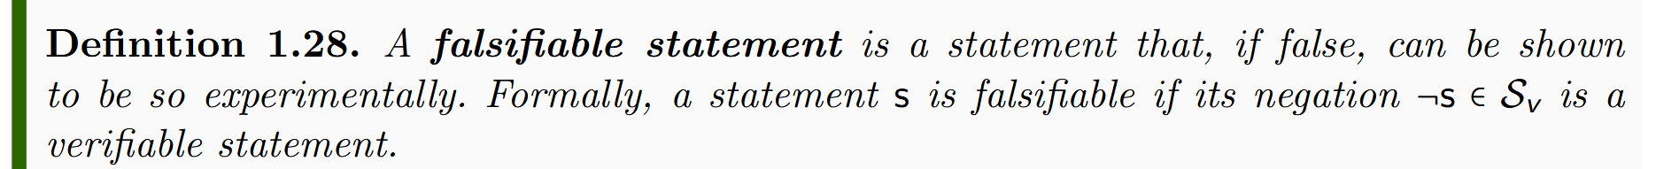

$$s$$ | $$e$$
T | SUCCESS (in finite time)
 | UNDEFINED
F | FAILURE (in finite time)
Statements are falsifiable if there is a test that always terminates with failure if the statement is true
Note that formally falsifiable is defined to be the negation of verifiable statements
Reduces the number of primitive concepts
$⇒$ The justification must show these definitions to be equivalent

Slide 44





Suppose $¬s$ is verifiable. Then we can find a test such that
From $e$, we can construct the test $e_{¬}(e)$ that switches SUCCESS with FAILURE
$e_{¬}(e)$:
Run test $e$
If $e$ fails, return SUCCESS
If $e$ succeeds, return FAILURE
$$s$$ | $$¬s$$ | $$e$$ | $$e_{¬}(e)$$
T | F | FAILURE (in finite time) | SUCCESS (in finite time)
 |  | UNDEFINED | UNDEFINED
F | T | SUCCESS (in finite time) | FAILURE (in finite time)
$⇒$ If the negation of a statement is verifiable, then the statement is falsifiable

Slide 45


$$s$$ | $$e$$
T | SUCCESS (in finite time)
F | FAILURE (in finite time)
Statements are decidable if there is a test that always terminates
Note that formally decidable statements are verifiable statements whose negation is verifiable
$⇒$ The justification must show these definitions to be equivalent

Slide 46






Construct the test $\hat{e}(e, e_{¬})$
Suppose $s$ is verifiable. Then we can find a test such that
$\hat{e}(e, e_{¬})$:
Initialize $n$ to 1
Run $e$ for $n$ seconds
If $e$ succeeds, return SUCCESS
Run $e_{¬}$for $n$ seconds
If $e_{¬}$ succeeds, return FAILURE
Increment $n$ and go to 2
$$s$$ | $$¬s$$ | $$e$$ | $$e_{¬}$$ | $$\hat{e}(e, e_{¬})$$
T | F | SUCCESS (in finite time) | FAILURE (in finite time) | SUCCESS (in finite time)
 |  |  | UNDEFINED
F | T | UNDEFINED | SUCCESS (in finite time) | FAILURE (in finite time)
 |  | FAILURE (in finite time) | SUCCESS (in finite time) | FAILURE (in finite time)
Suppose $¬s$ is verifiable. Then we can find a test such that
$⇒$ If $s$ and $¬s$ verifiable, then the statement is decidable

Slide 47


Certainties and impossibilities are true and false by definition. Yet, we can make trivial tests for them.
$e_{⊤}$:
return SUCCESS
$e_{⊥}$:
return FAILURE

Slide 48


Conjunction (AND) of verifiable statements: check that all tests terminate successfully
$∧(e_{i})$:
Run all $e_{i}$
If all succeed, return SUCCESS
Return FAILURE
$⇒$ Only finite conjunction is guaranteed to terminate

Slide 49



Disjunction (OR) of verifiable statements: check that ONE test terminates successfully
$∨(e_{i})$:
Initialize $n$ to 1
For each $i=1…n$
Run $e_{i}$ for $n$ seconds
If $e_{i}$ succeeds, return SUCCESS
Increment $n$ and go to 2
watch out for non-termination!
$⇒$ Only countable disjunction can reach all tests

Slide 50



For decidable statements, we need both the statement and its negation to be verifiable
$¬ \bigwedge{e_{i}}=\bigvee{¬e_{i}}$
$¬\bigvee{e_{i}}= \bigwedge{¬e_{i}}$
Using De Morgan properties, we can construct tests using test for negation

Slide 51
Experimental domain

Slide 52



What is the largest set of verifiable statements it makes sense to consider?
$$s_{1},s_{2},s_{3},…, s_{n}, …$$
Note: even assuming an indeterminate amount of time, we can only run up to countably many tests
$$s_{1}∨s_{2},s_{1}∧s_{2}, …$$
However, testing those statements implicitly tests all other statements that depend on those
$⇒$ Set of verifiable statements whose truth can be verified by running countably many tests

Slide 53





$$𝒟$$
$$ℬ=\{e_{1},e_{2},e_{3},…\}$$
$$ℬ$$
Only finite conjunction and countable disjunction
$$s_{1}=\left(e_{1}∨e_{3}\right)∧e_{2}…$$

Slide 54
$$𝒟$$
$$ℬ=\{e_{1},e_{2},e_{3},…\}$$
$$ℬ$$
Countable basis
Only finite conjunction and countable disjunction
$$s_{1}=\left(e_{1}∨e_{3}\right)∧e_{2}…$$

Slide 55
Every physical theory must be fully characterized by an experimental domain
All its content must be expressible in terms of verifiable statements
The theory must be fully explorable with a countable set of tests

